Slide 1



Cohort Analysis
By Laurids Klevenhaus

Slide 2


For this project I used MySQL and DBeaver to run queries…

Slide 3

…And Tableau as the visualization software

Slide 4

Project & Data Brief
Purpose: To understand what a cohort analysis is, how to handle missing values, extract date parts from a date field, how to create a cohort index and table for retention rate and visualize in Tableau.
Data: This is a transnational data set which contains all the transactions occuring between 01/12/2010 and 09/12/2011 for a UK-based non-store online retail.
Source:
https://archive.ics.uci.edu/ml/datasets/Online+Retail
8 columns, 541.909 records
1. InvoiceNo
2. StockCode
3. Description
4. Quantity
5. InvoiceDate
6. UnitPrice
7. CustomerID
8. Country

Slide 5

1. Inspect And Clean The Data

Slide 6
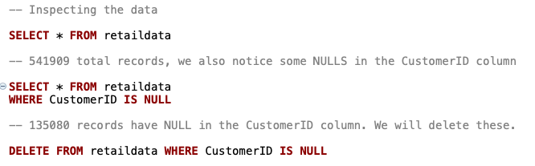
I notice that there are 135.080 records with null values in the ”CustomerID” column and remove these

Slide 7
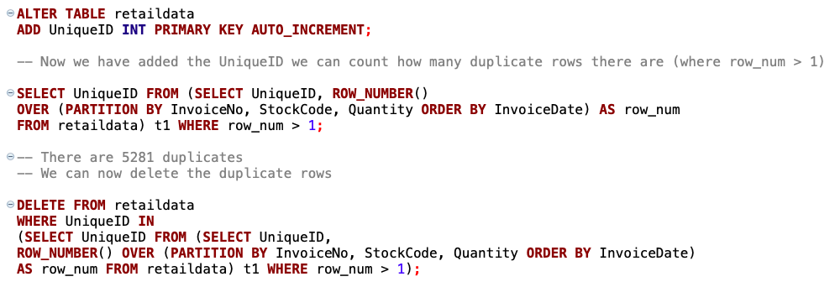
I will check for duplicates by assigning duplicates with a value of >1 (If row_num is 2+ it means there is a duplicate). For this method to work I need to add a UniqueID column first.
Notes:
Now I will check for duplicates by assigning duplicates with a value of >1 (If row_num is 2+ it means there is a duplicate).
Since the table has no UniqueID as Primary Key, a UniqueID is needed for this method to work properly.
So a UniqueID column will be added to start with.

Slide 8

Another thing we need to consider is to remove the negative quantities there seems to be when items have been returned / orders cancelled
Notes:
Another thing we need to consider is to remove the negative quantities there seems to be when items have been returned.
If not dealt with, this will mess up any analysis using the quantity (and price for that matter) column (8841 instances of Quantity < 0)

Slide 9
2. Cohort Analysis

Slide 10
Cohort Analysis
A cohort analysis is an analysis of several different cohorts to get a better understanding of behaviors, patterns and trends
A cohort is a group of people with something in common
Performed to better understand the behavior of the customers and to see patterns and trends
I am performing a time based cohort analysis to see the customers’ behavior after their initial purchase

Slide 11
Data Required For Cohort Analysis
Unique Identifier (CustomerID)
Initial Start Date (First invoice date → First time the customer purchased something at the store)
Revenue data (sales, price, unit)

Slide 12
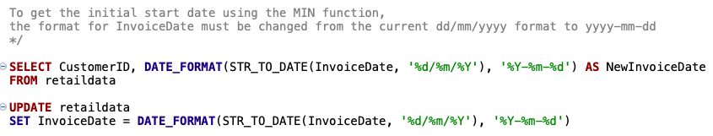
To get the initial start date using the MIN function, the format for InvoiceDate must be changed from the current dd/mm/yyyy format to yyyy-mm-dd

Slide 13
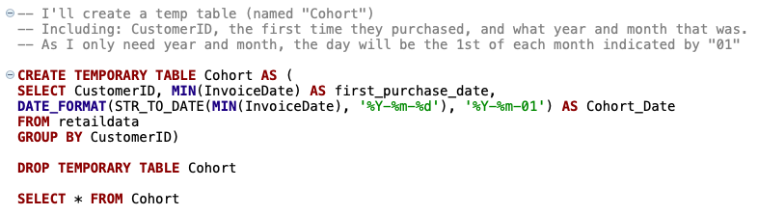
I’ll create a temp table (named Cohort) including CustomerID, first time they purchased (MIN InvoiceDate) in yyyy-mm-dd format, and the cohort_date in yyyy-mm-01 format

Slide 14
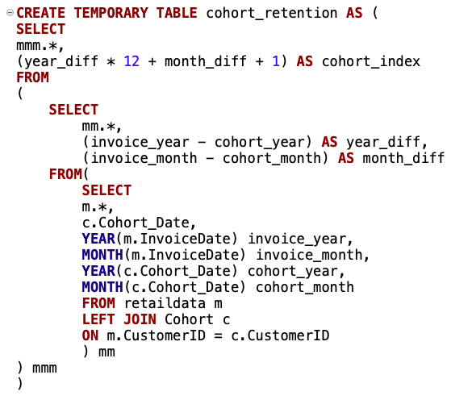
Next, I’ll create a cohort index which is an integer representation of the number of months that has passed since the customers first purchase
See comments
Notes:
Comments:
I select everything from the original “retaildata” table and join on the “cohort” temp table created on the previous slide.
Then to get the time that has passed since there first purchase and their next and “X” purchase after that I subtract the cohort_year from invoice_year to get year_diff and the cohort_month from the invoice_month to get the month_diff. The “YEAR” and “MONTH” functions let me extract the specific year and month from the full date.

Slide 15
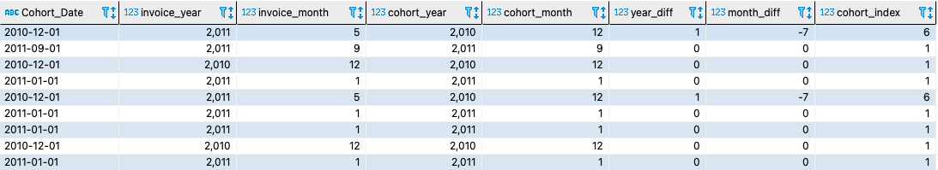
Cohort_index (int from 1-13) shows when a purchase was made since the first. If cohort_index = 1 the purchase was made in the same month as the first If cohort_index = 2 the purchase was made in the second month after the first and so on

Slide 16
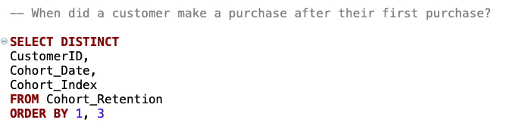
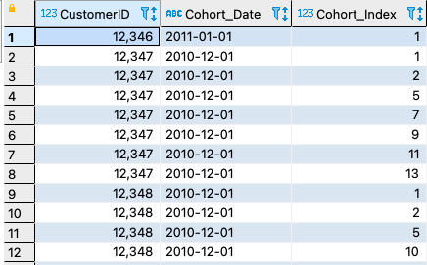
How to interpret the index? See comments
Notes:
How to interpret the index?
Example: Customer “12.347” made their first purchase (cohort_index = 1) December 2010 (their cohort_date) and then made the second purchase in the month after the first (cohort index = 2), the third purchase they made in the fifth month after the first, the fourth purchase in the seventh month after the first and so on.

Slide 17
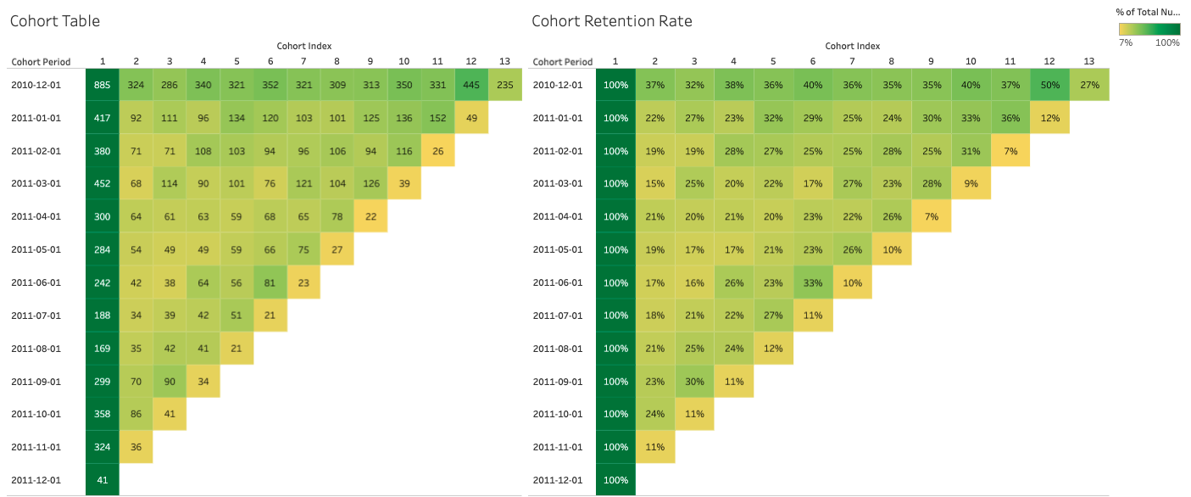
Cohort Table and Cohort Retention Rate in Tableau
Link: https://public.tableau.com/views/CohortRetentionDashboard/CohortRetentionDashboard?:language=en-GB&:display_count=n&:origin=viz_share_link
Notes:
Interpretation: Given a cohort date of December 2010 (So customers making their first purchase in 2010-12), the numbers in the table indicates the amount of customers that returned in the following months after that indicated by the index (1-13)
Example: 885 made their first purchase in December, 2010. Of those 885, 324 made a purchase in the month after that, 286 made a purchase in the 3rd month and so on.

